Slide 1
Stock Prediction using Neural Networks
Project Advisor
Dr. Gokay Saldamli
Mahesh Reddy Konatham [013823095]
Mohdi Habibi [010302851]
Shreya Hagalahalli Shrinivas [013821405]
Sneha [013850174]

Slide 2
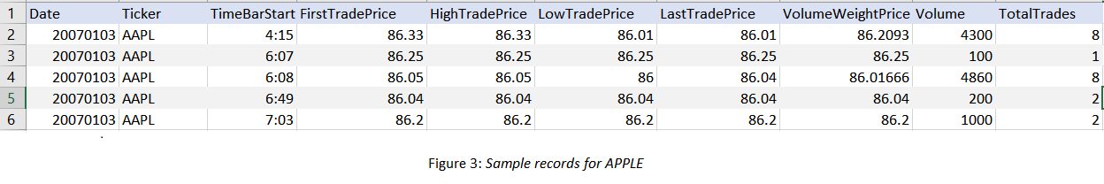
System Design & Implementation
Project execution setup & development tools acquisition
Acquiring quality data - Apple(AAPL), Baidu Inc(BIDU), Chipotle Mexican Grill (CMG), Ebay(EBAY) etc.
Data Preprocessing - OHLC (average of Open, High, Low and Close prices)
Implementation of initial baseline models - Random Forest ,Multilayer Perceptron.
Implementation of final model-LSTM neural network
Training, Testing and Evaluating the predicted results

Slide 3
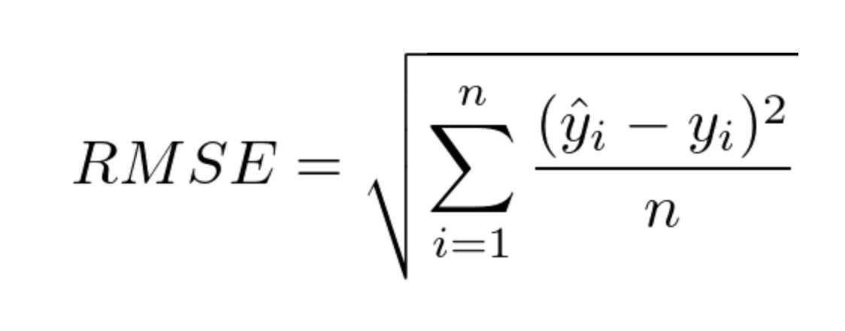
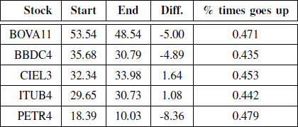
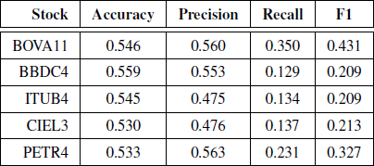
Evaluation Methody
Accuracy , Precision , Recall, F1 score
Root Mean Square Error (RMSE)

Slide 4
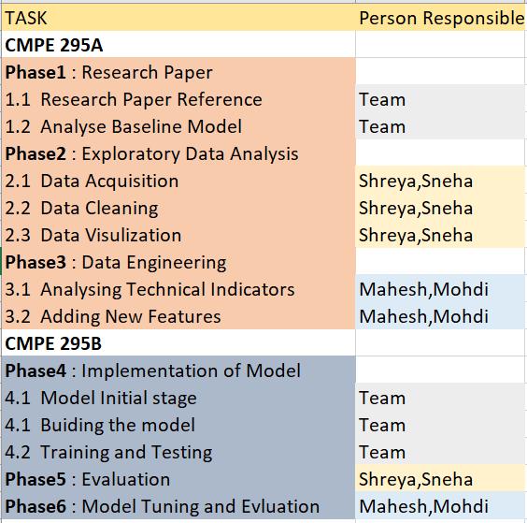
Implementation Plan and Progress

Slide 5
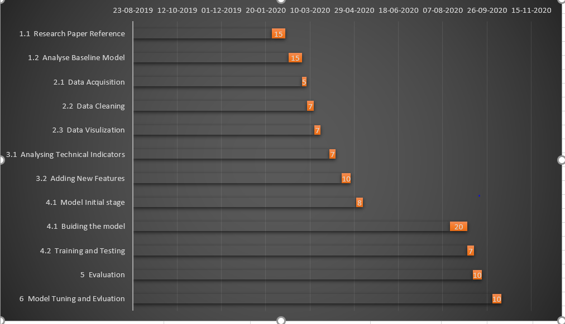
Project Planning

